Slide 1



DASP 3.01
Improvements compared to DASP 2.3
By Araar Abdelkrim
Sunday, September 19, 2021

Slide 2
DASP 3.0 a NEW PEP realisation.
Compared to the DASP 2.3, the new version of DASP version (DASP 3.0) includes many helpful improvements, which can facilitate the work of practitioners for the study of distributive analyses or program evaluations.
This work was financed by PEP, and I would like to thank the PEP network for its support to this project.
In what follows, we will introduce these improvements.

Slide 3
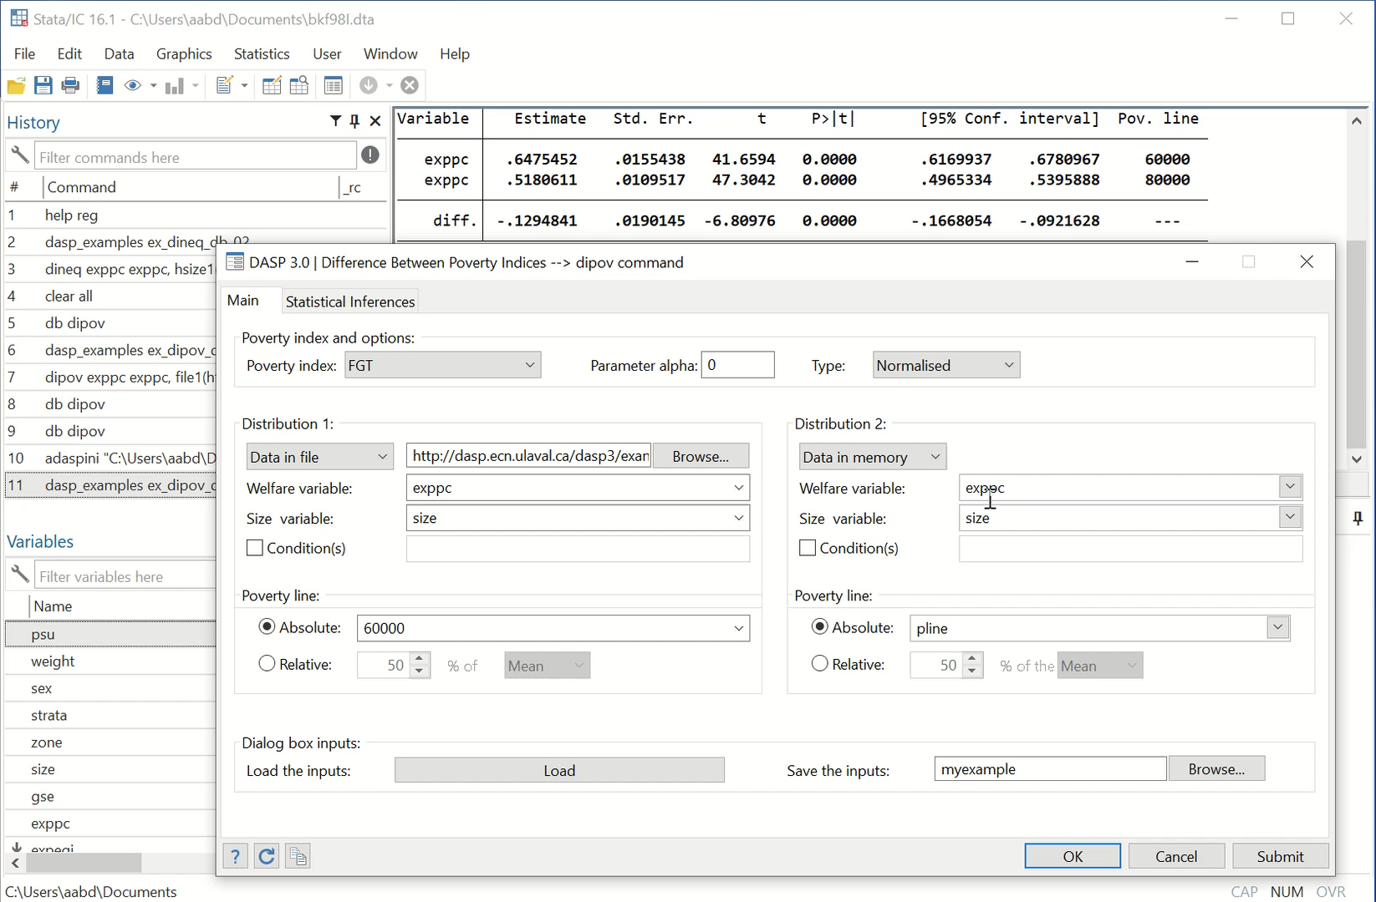
DIALOG BOXES.
For most popular indices, the user can save dialog BD information, and then, can load it in a another Stata session.
Video 1

Slide 4
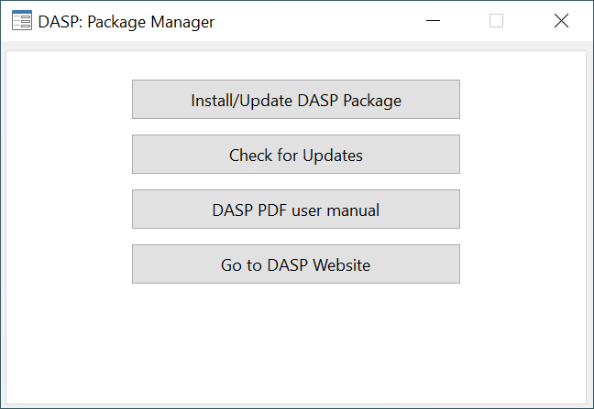
DIALOG BOXES.
The new DASP Package Manager enables an easy management of the package.

Slide 5
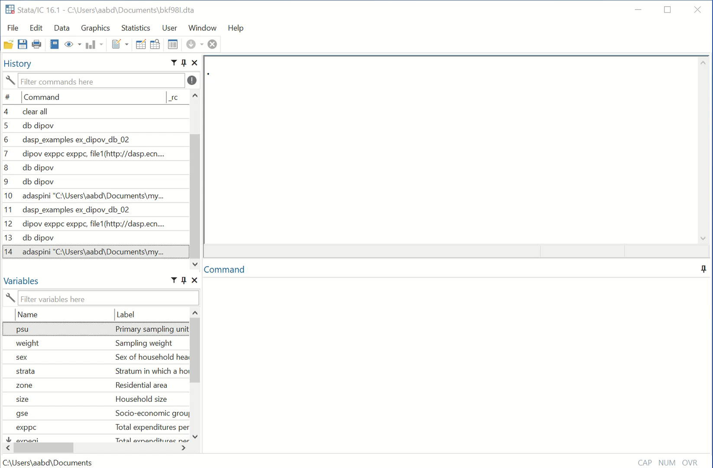
DIALOG BOXES.
Now, by working with two distributions, lists of variables will be automatically loaded.
The user can indicate the poverty line as a numerical value or a variable.
Video 2

Slide 6
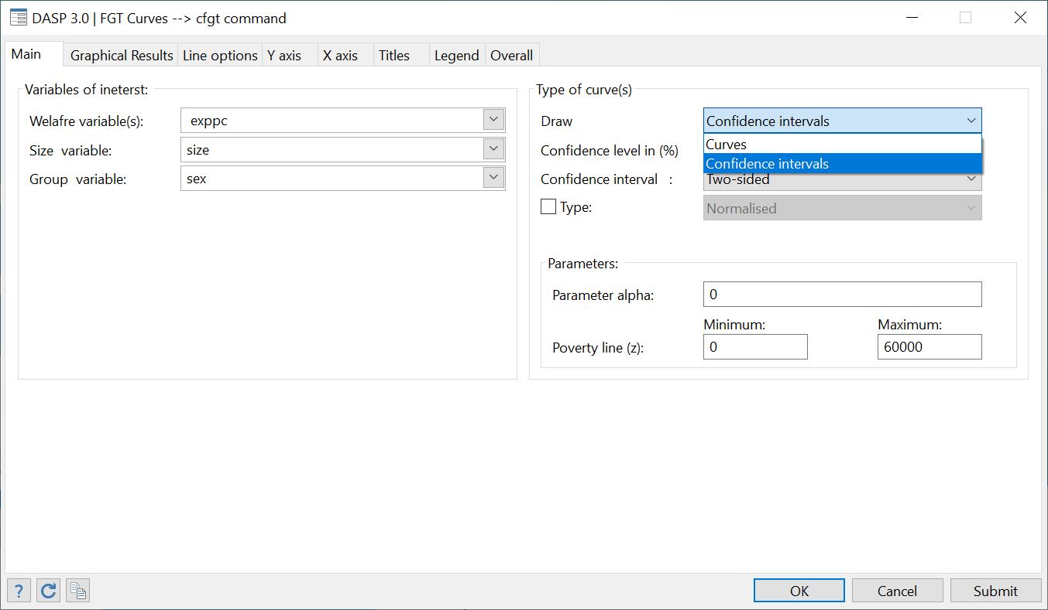
DASP CURVES.
All of the DASP curves are improved.
Also, for many DASP curves, the user can display the confidence interval.

Slide 7
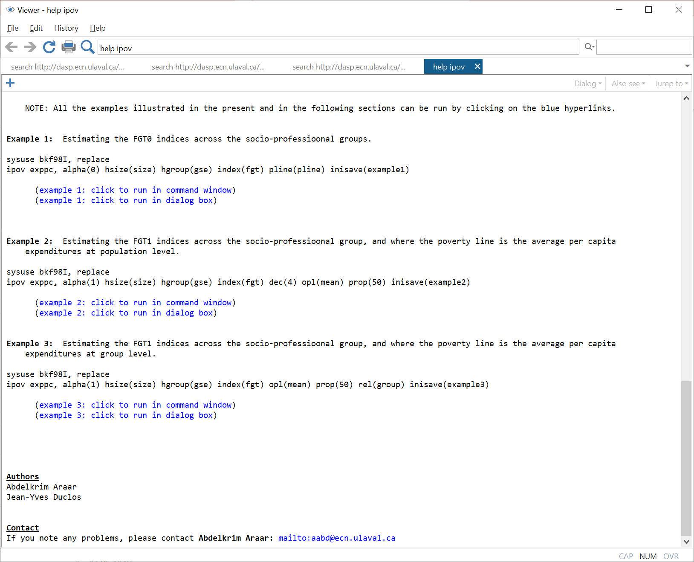
DASP HELP.
For the most popular modules, dynamic examples were added (click and watch). This will help to practice easily, and to be familiar with the DASP package.
For the datafiles of the different examples in help files, the user can open them by using the command sysuse.

Slide 8
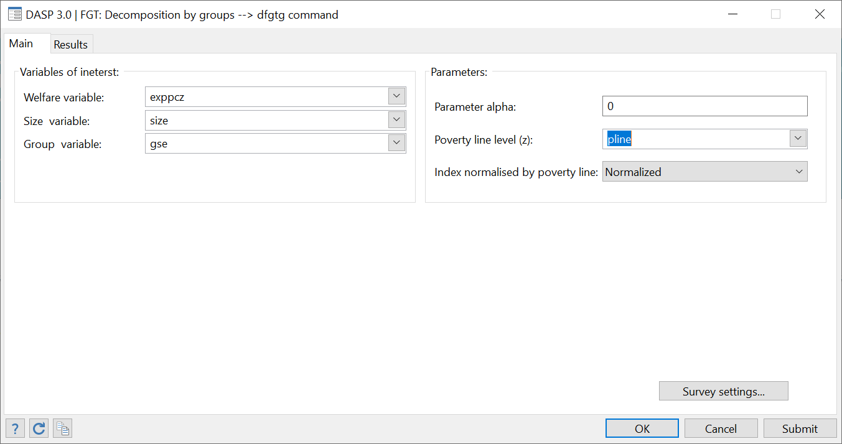
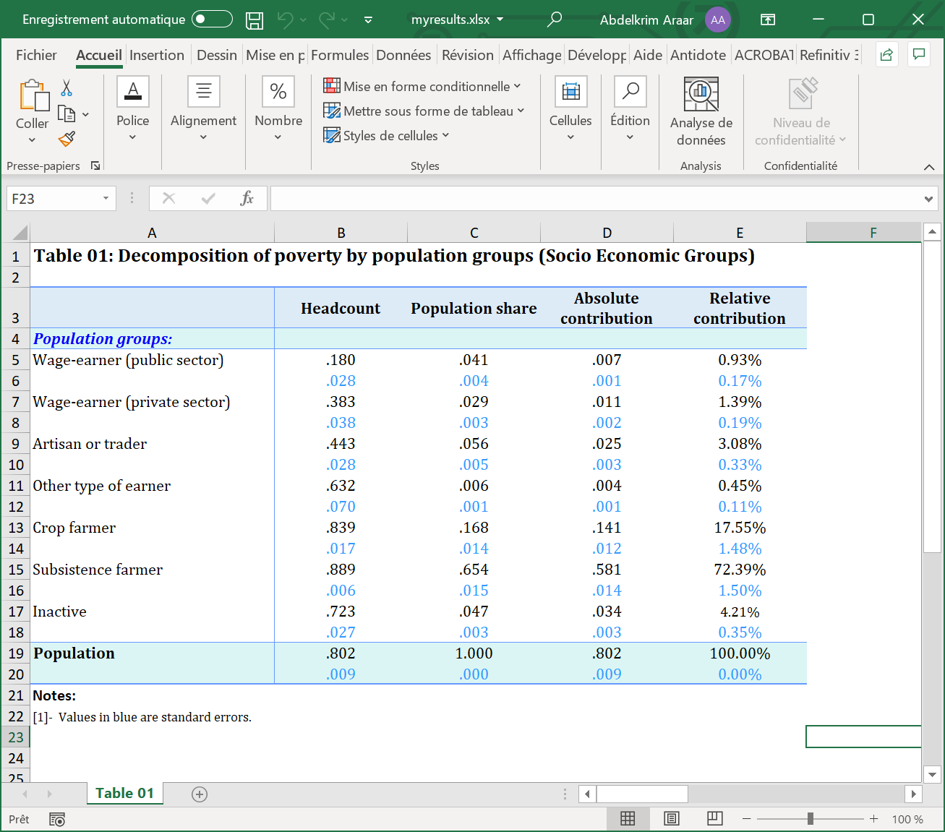
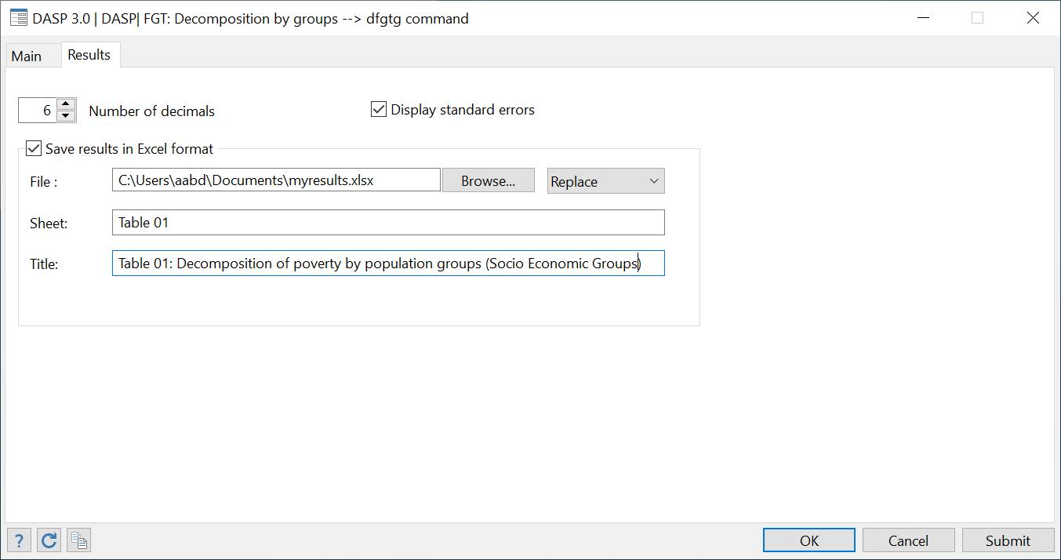
DASP and SAVING IN EXCEL FORMAT RESULTS.
For a set of modules with long results, the user can save these results in an Excel file (remember that the older format was *.xml).

Slide 9
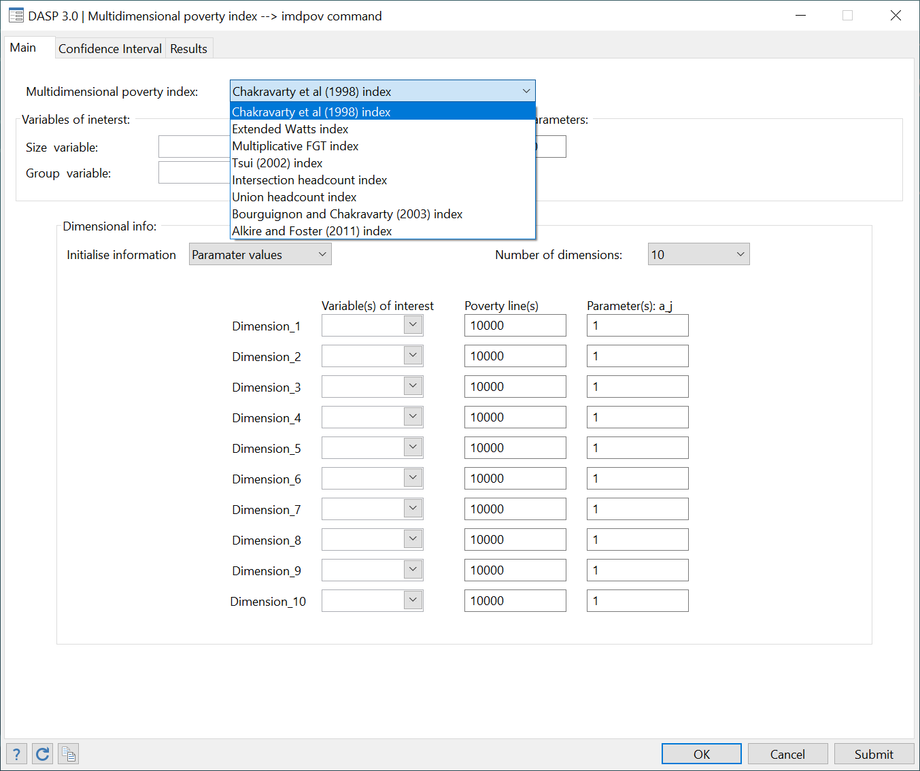
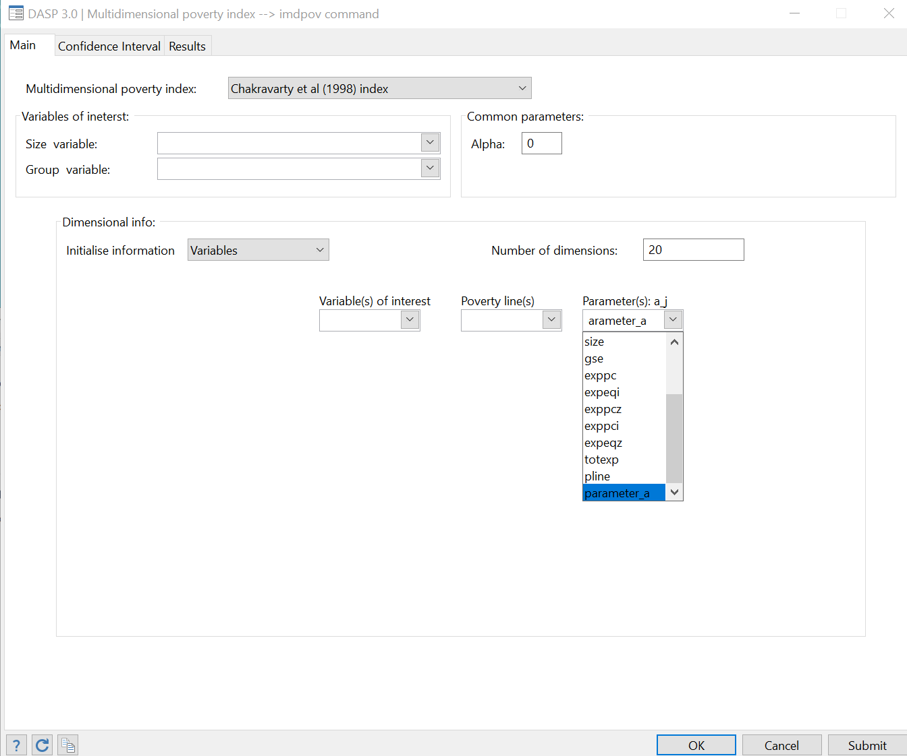
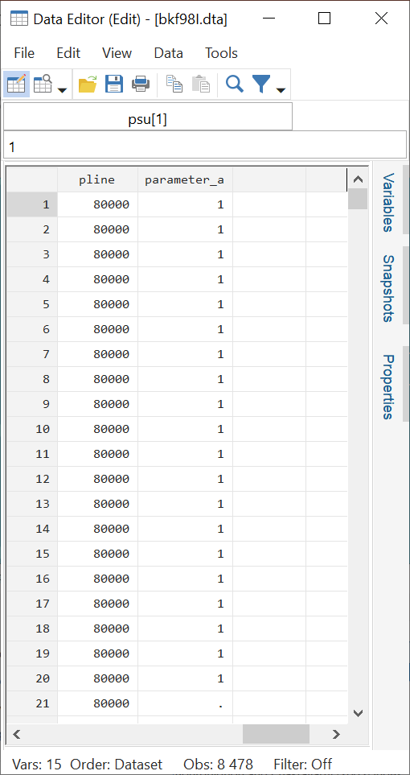
DASP and MULTIDIMENIONAL POVERTY.
For all MD Poverty indices, the user can select until 10 dimensions.
Otherwise, the user can put the parameter values as a variable, and then estimate for any number of dimensions.

Slide 10
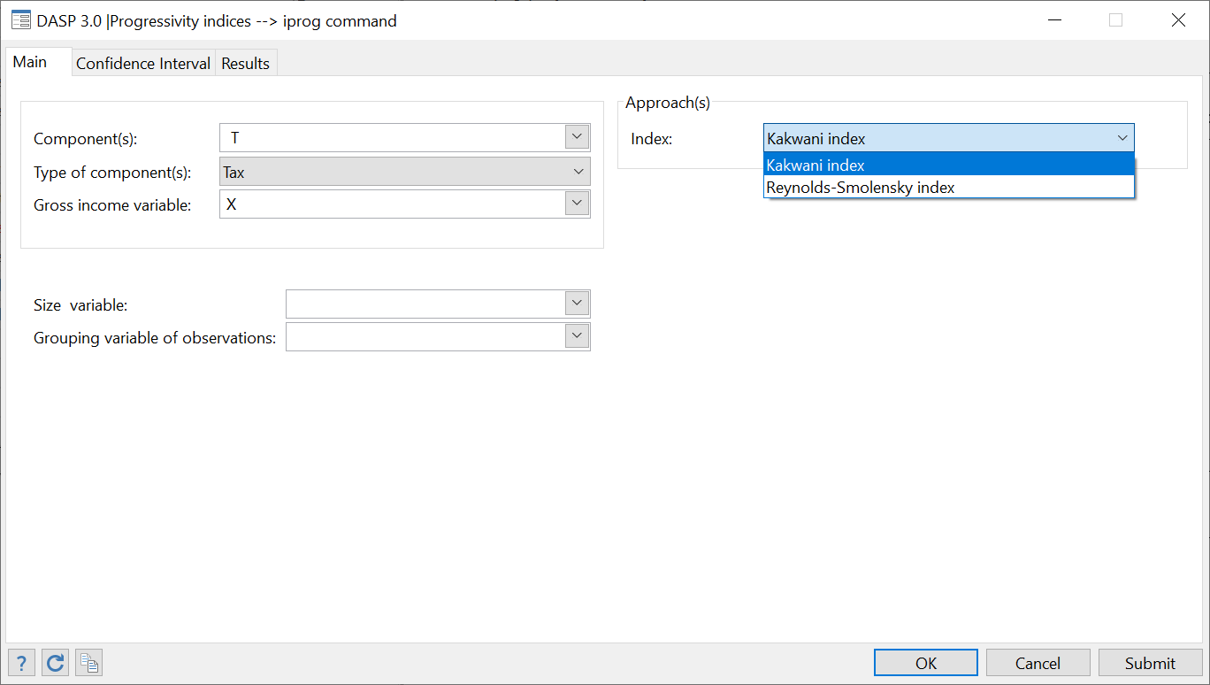
DASP 3.01 and ADDED MODULES.
Progressivity indices (iprog)

Slide 11
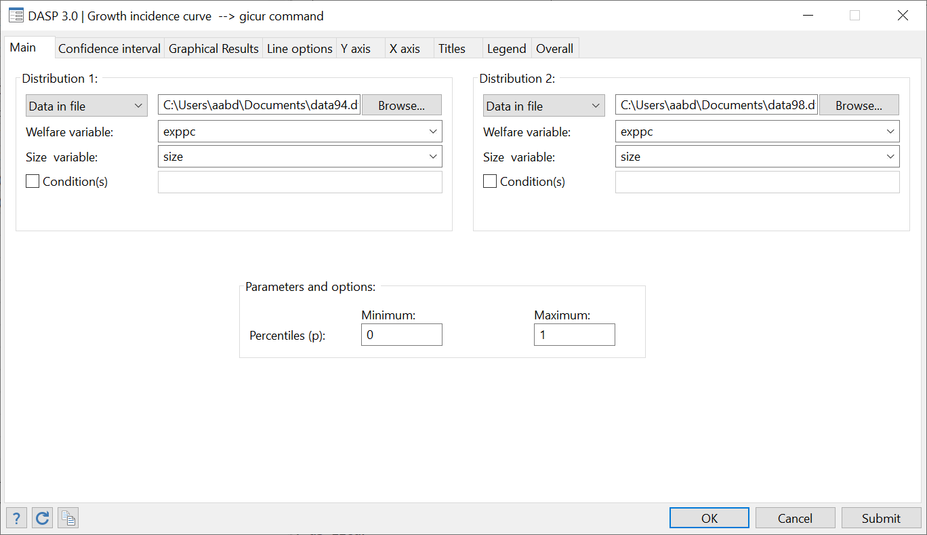
DASP 3.01 and ADDED MODULES.
Growth Incidence Curve (gicur)

Slide 12
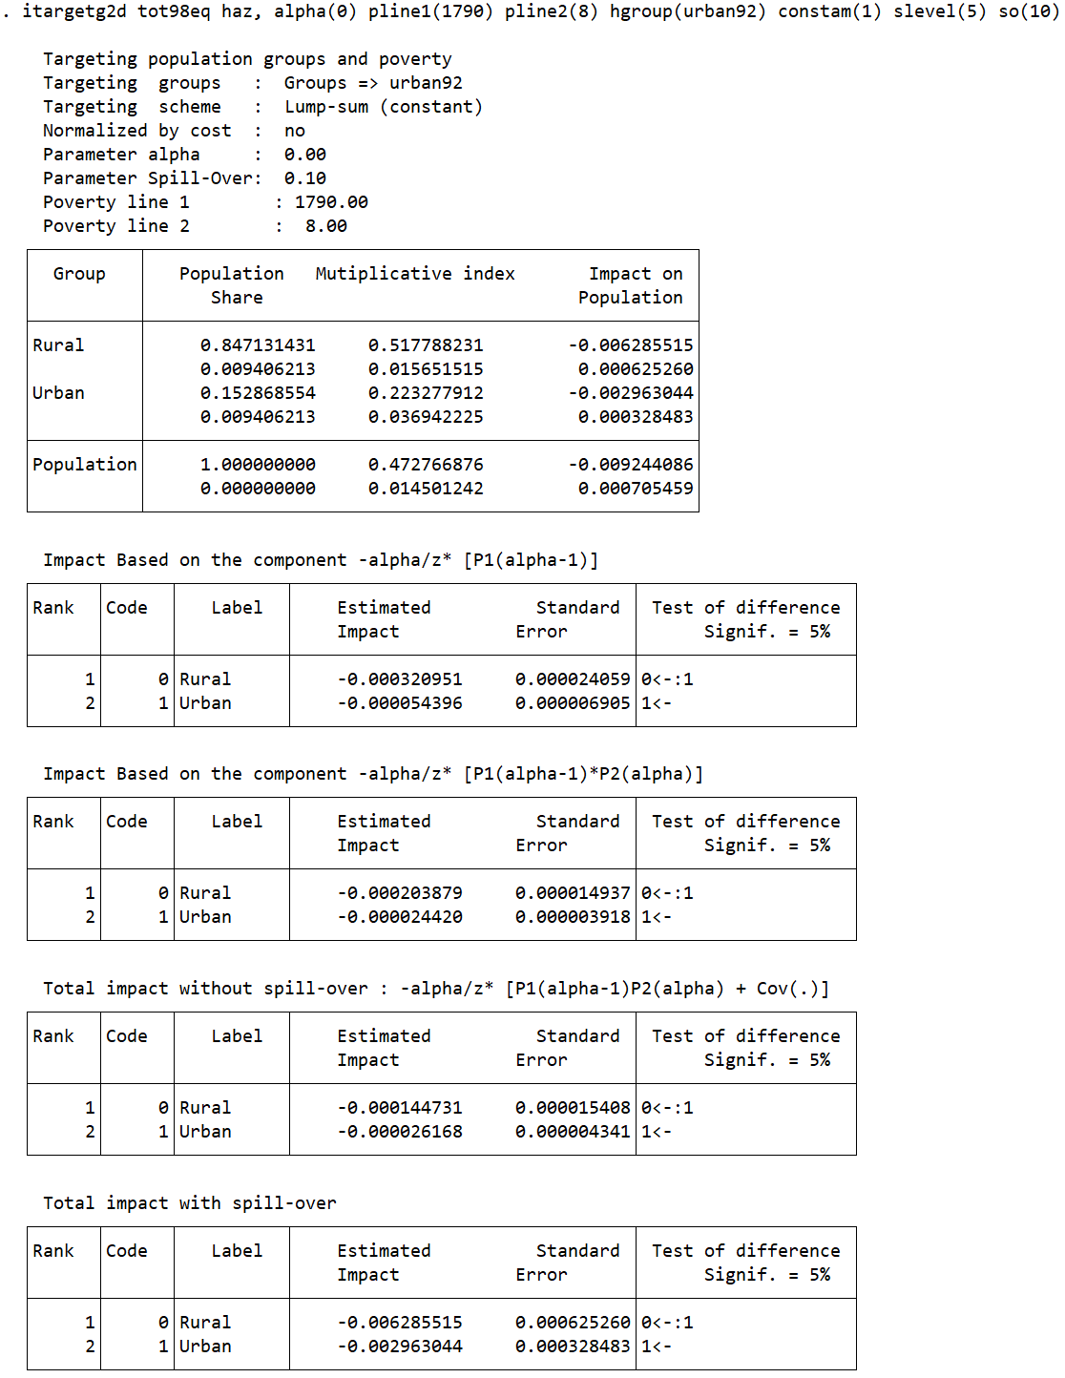
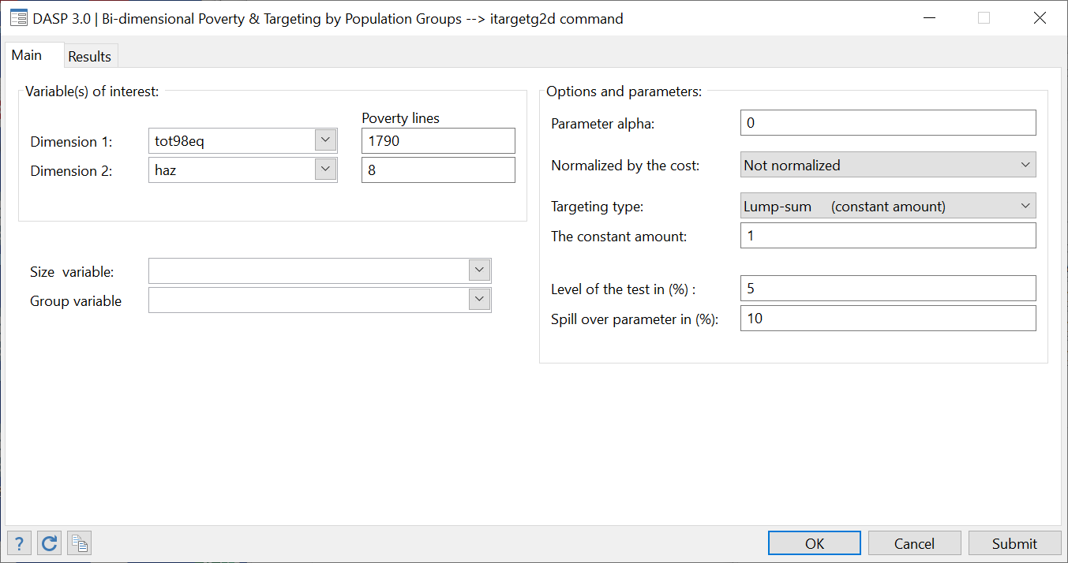
DASP 3.01: NEW MODULES.
Bi-dimensional poverty targeting of population groups: itargetg2d

Slide 13
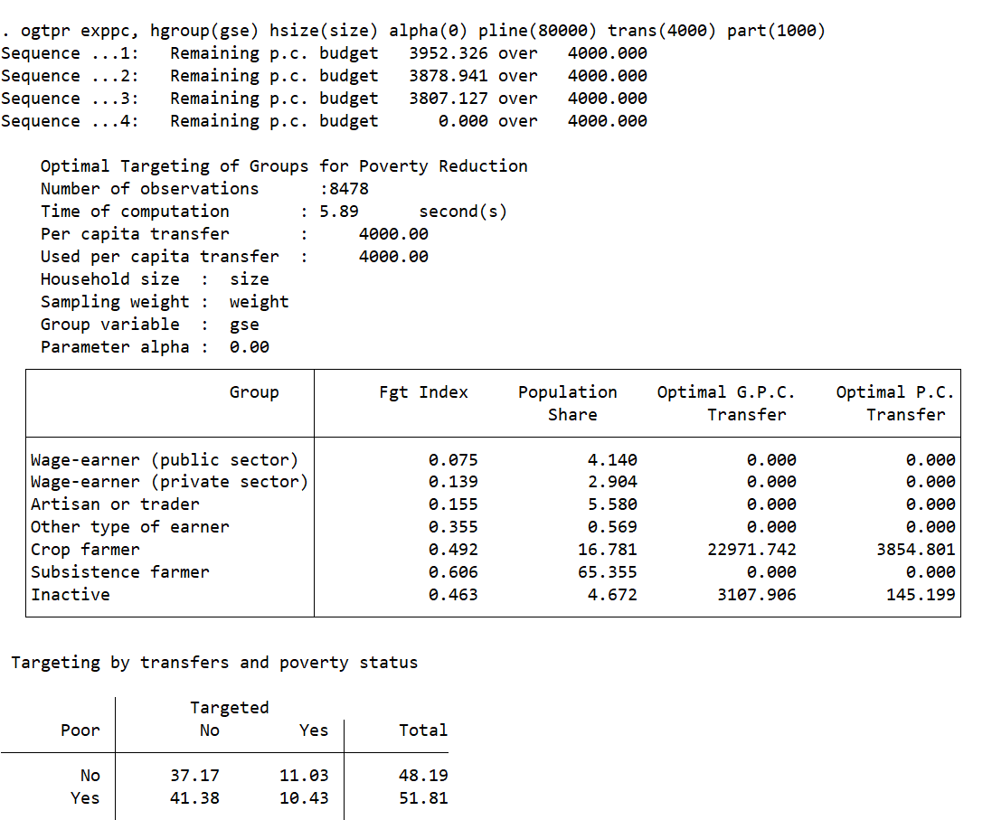
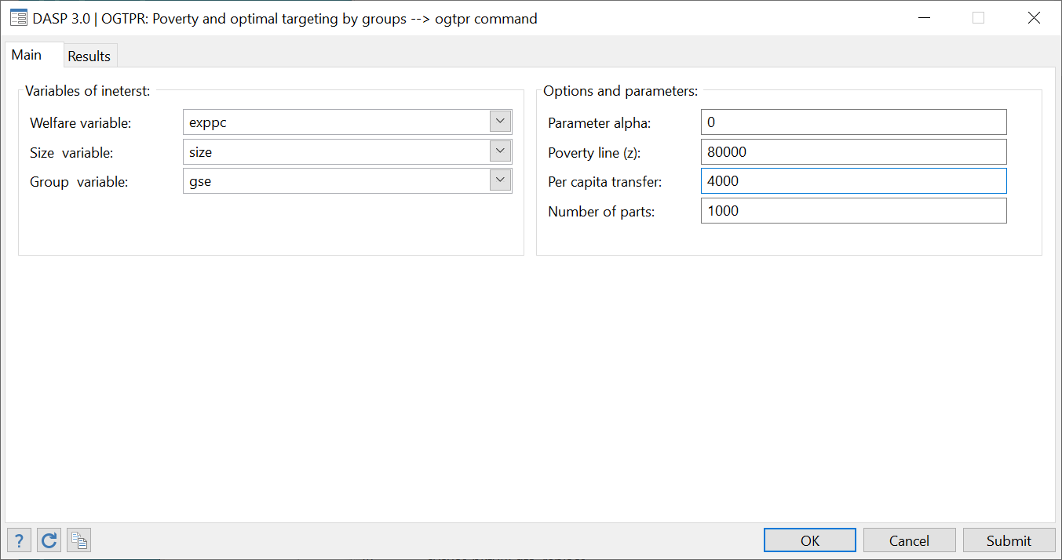
DASP 3.01: NEW MODULES.
Optimal population group targeting with fixed budget (ogtpr)

Slide 14
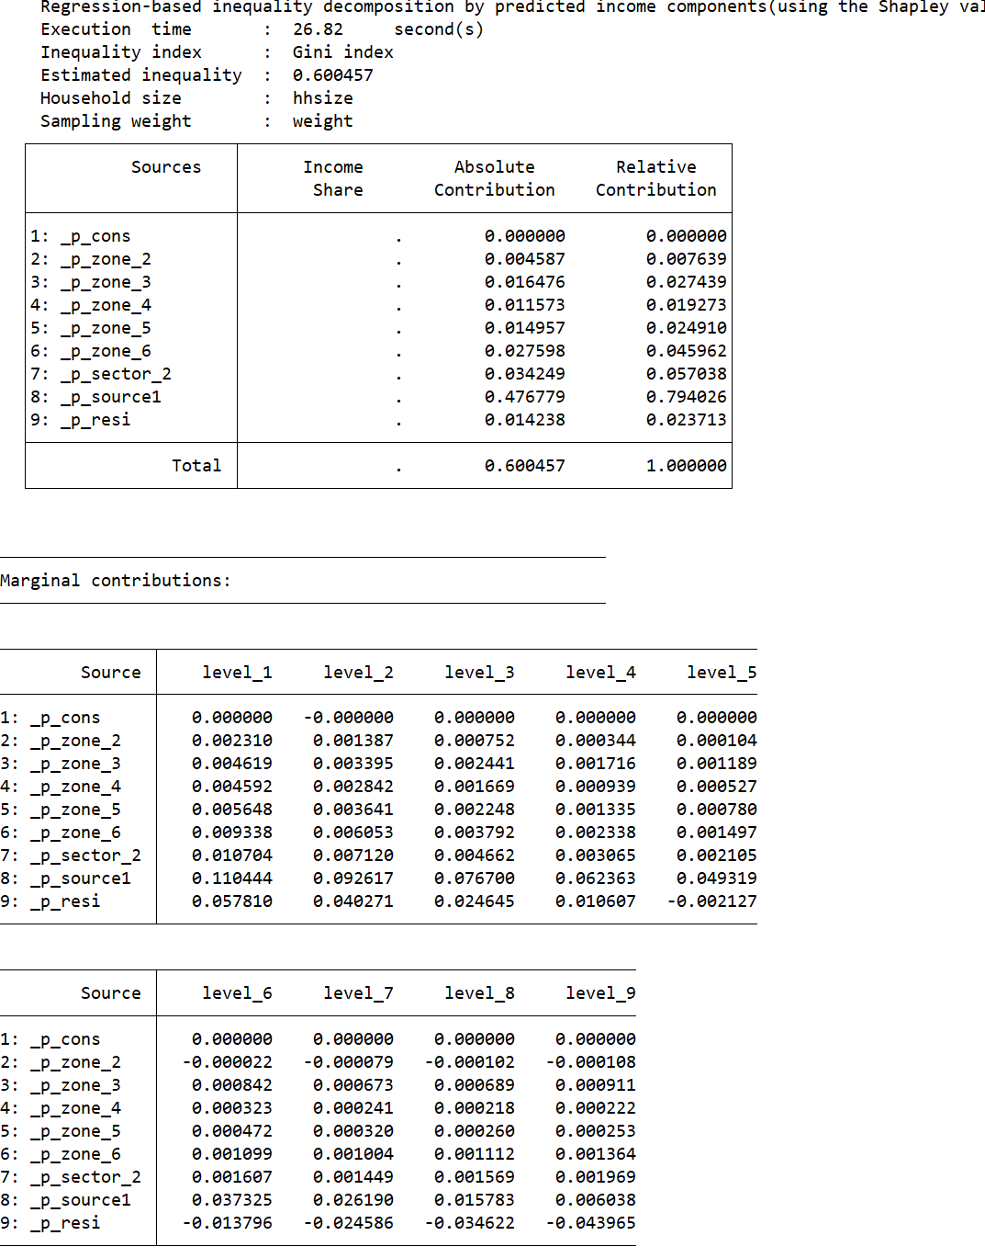
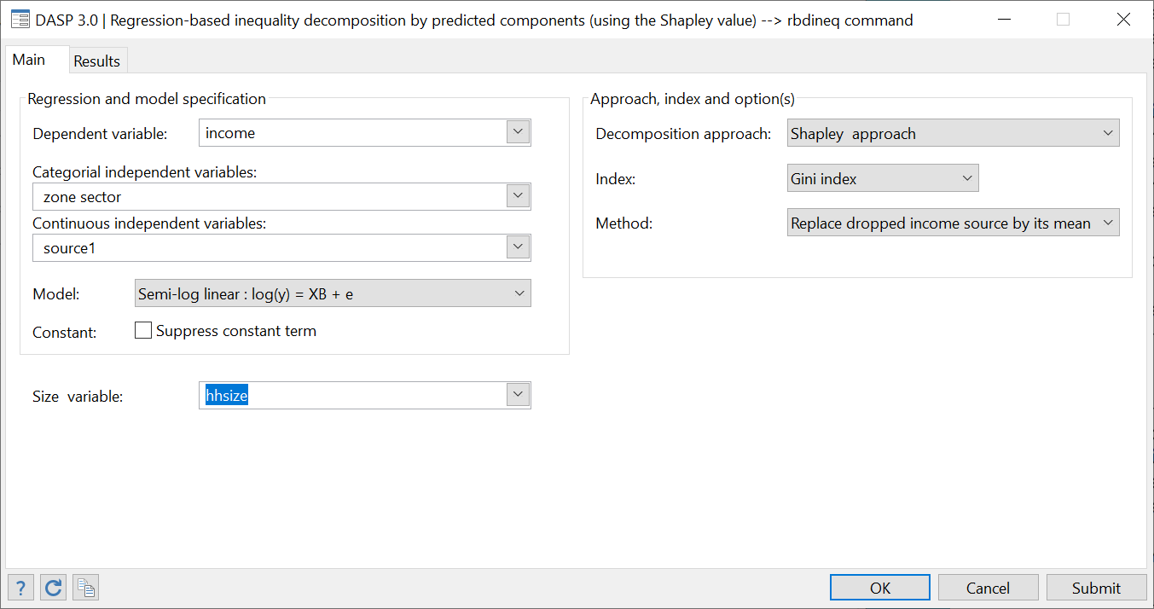
DASP 3.01: SOME IMPROVED MODULES.
Regression-based inequality decomposion (rbdineq): Now the user can indicate the categorical independent variables separately.

Slide 15
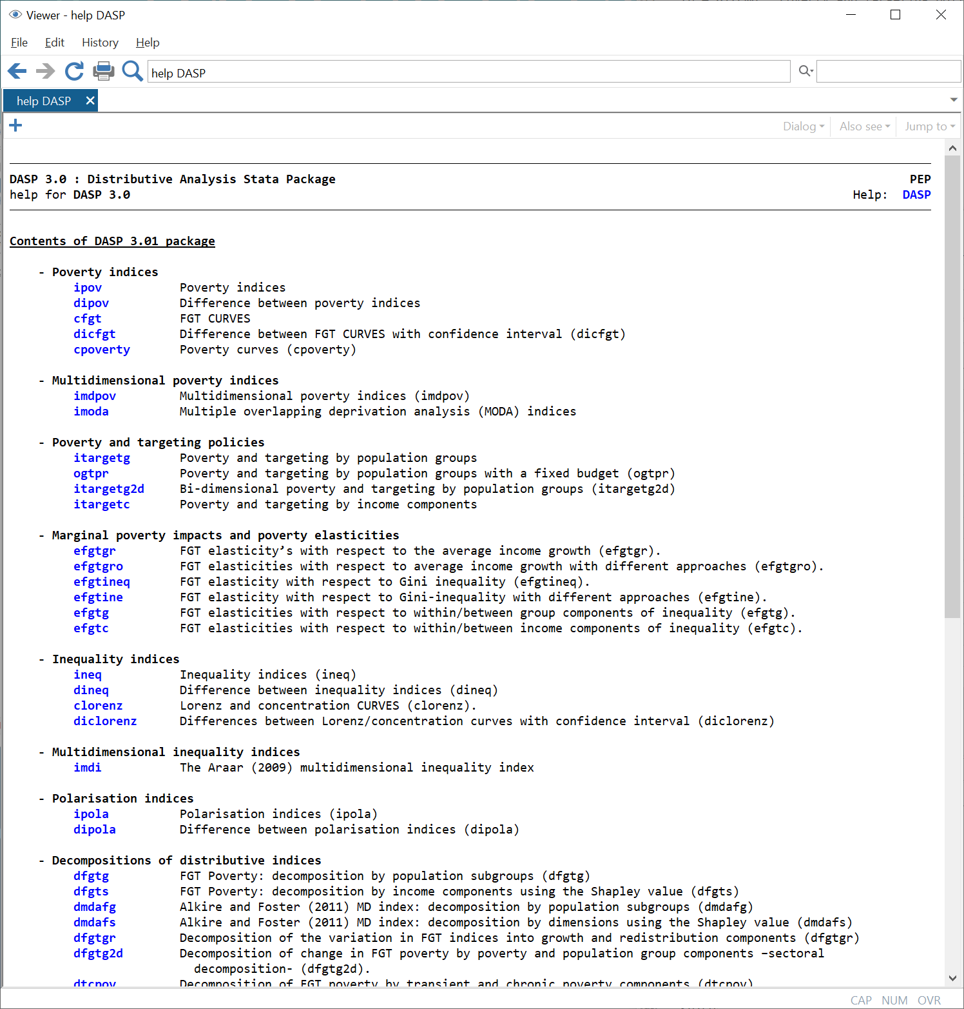
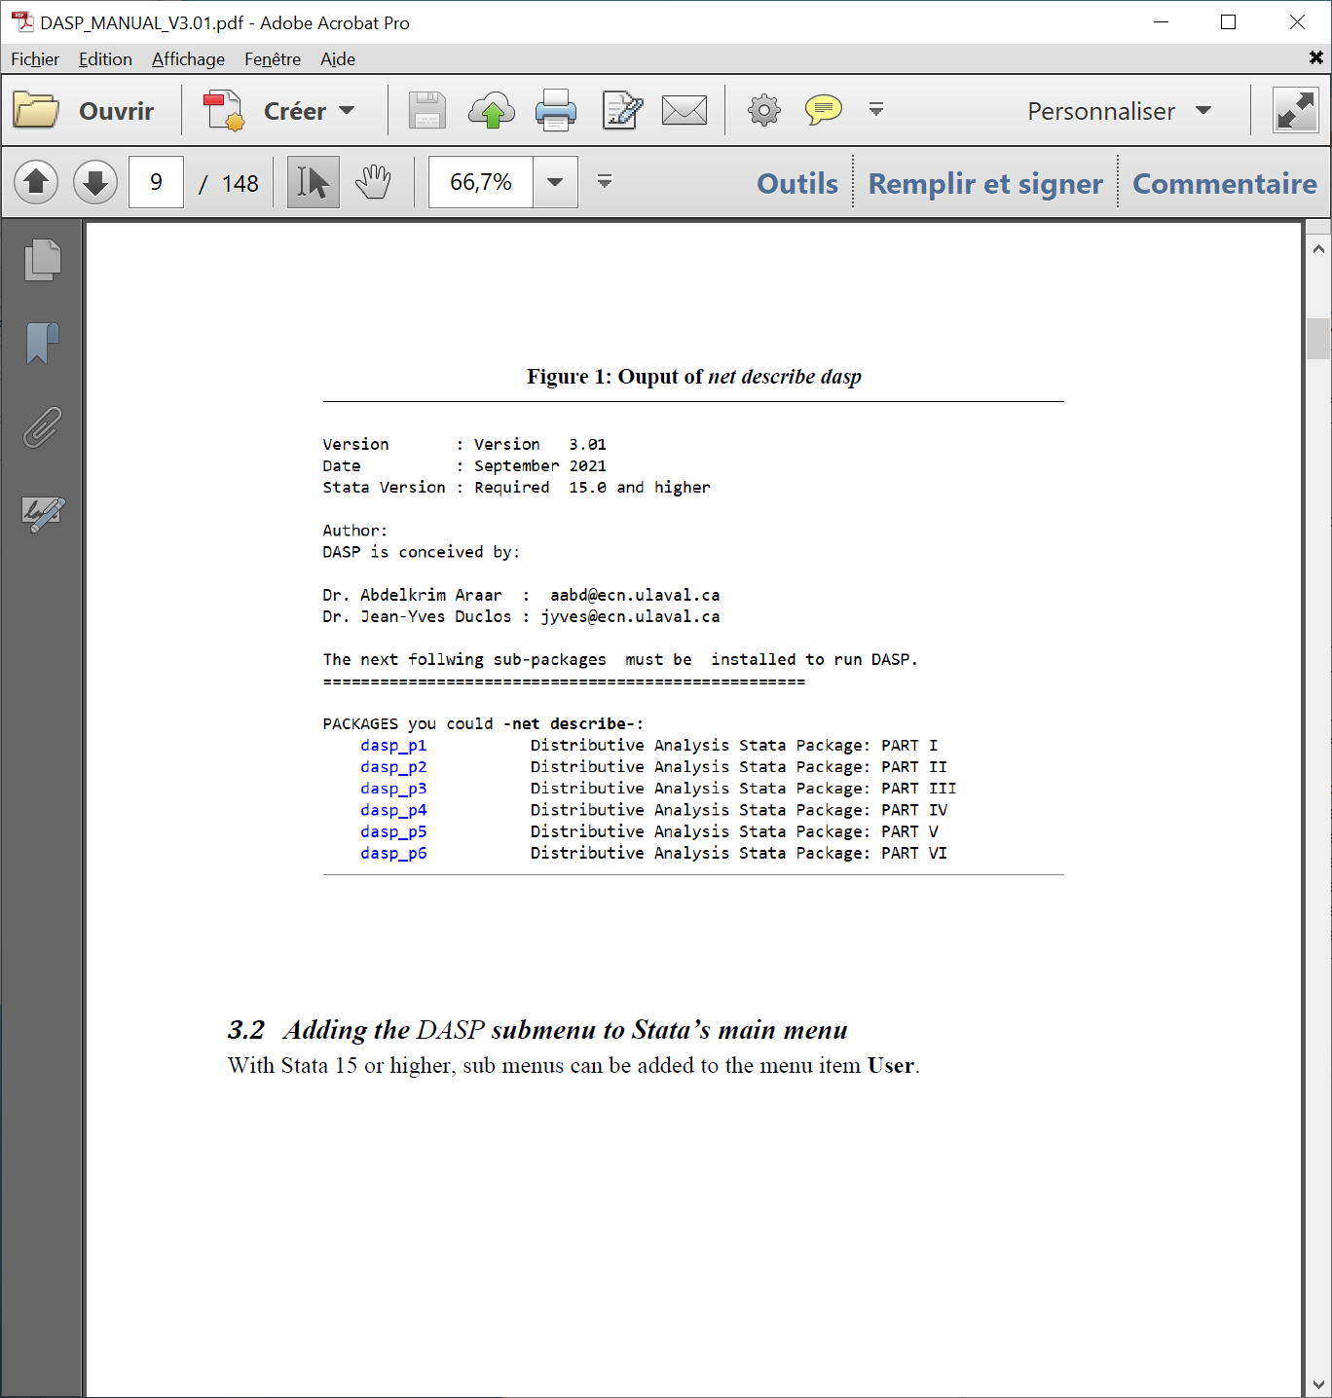
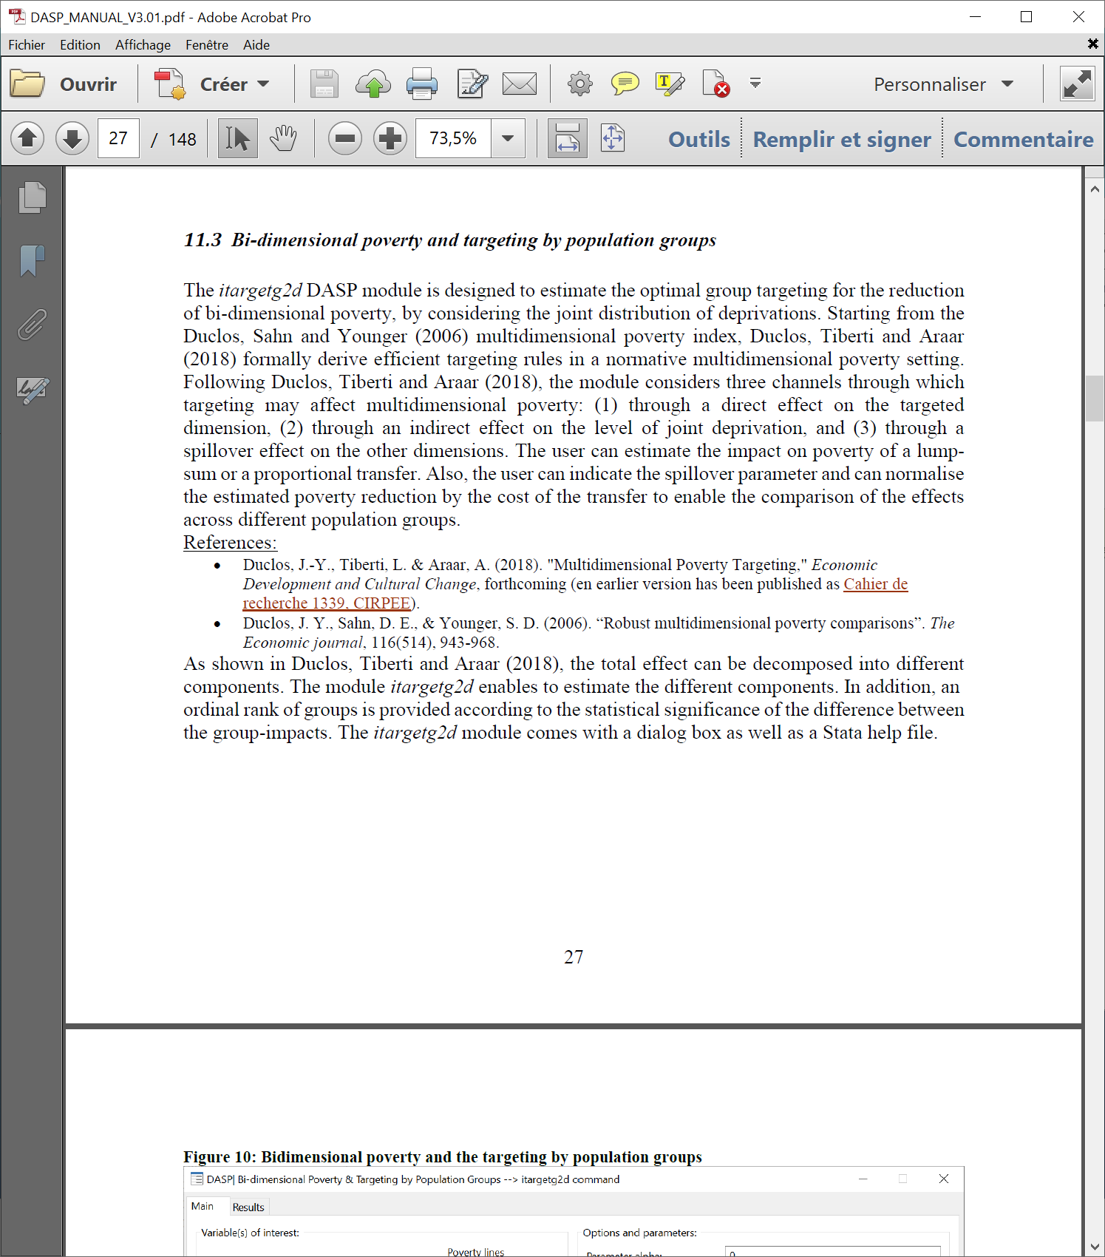
DASP 3.01 USUER MANUAL IS UPDATED.

